Slide 1
Government polytechnic Bagepalli
Name : Nitesh.p
Reg no:136CS21037
Program:3rd year ,cse
Course: cyber security
Transport layer security

Slide 2

Definition of TLS ?
Transport Layer Security, or TLS, is a widely adopted security protocol designed to facilitate privacy and data security for communications over the Internet.
TLS is a security protocol that provides privacy and data integrity for Internet communications
TLS was derived from a security protocol called secure sockets layer(SSL)
Tls is a protocol that ensures privacy between communicating application and their users on the internet.

Slide 3
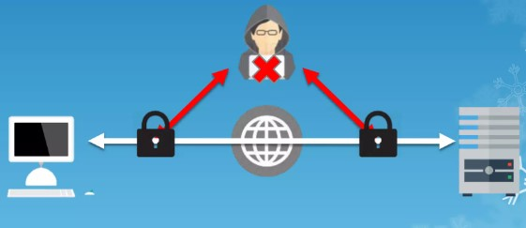
Why do we need TLS ?
TLS ensures that no third party may eavesdrop or tamper with any message.
TLS encrypts data sent over the internet to ensure that hackers are unable to see what you transmit or transfer your private information.

Slide 4
Components of TLS with explanation
Encryption : Hides the data being transferred from third parties.
Authentication : ensures that the parties exchanging information are who they claim to be.
Integrity : verifies that the data has not been forged or tampered with

Slide 5
Types of TLS ?
Domain Validation: A domain validated certificate (DV) is an X. 509 public key certificate typically used for Transport Layer Security (TLS) where the domain name of the applicant is validated by proving some control over a DNS domain.
Organization Validation: Organization Validation: A higher assurance TLS/SSL that strengthens security by verifying the organization's information in the certificate against an independent CA; this tells visitors to the site that it is associated with a real organization, which deters fraudulent activities such as phishing.
Extended Validation :

Slide 6
History of the protocol
SSL 1.0
– Internal Netscape design, 1994
– Not publicly released
• SSL 2.0
– Published by Netscape, 1995
– Several weaknesses
• SSL 3.0
– Designed by Netscape and Paul Kocher, 1996
• TLS 1.0
– IETF makes RFC 2246 based on SSL 3.0, 1999
– Not interoperable with SSL 3.0
TLS uses HMAC instead of MAC; can run on any port

Slide 7
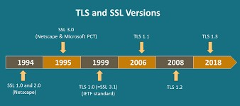
History of TLS
TLS 1.1, 2006
– RFC 4346
– Protection against cipher-block chaining (CBC) attacks
TLS 1.2, 2008
– RFC 5246
– More options in cipher suite
TLS 1.3, 2018
– Published as RFC 8446
– Some insecure ciphers removed (RC4, DES,...)
– streamline RTT handshakes (e.g. 0-RTT mode)

Slide 8
TLS Basics
• TLS consists of two main protocols
– Familiar pattern for key exchange protocols
• Handshake protocol
– Use public-key cryptography to establish a shared
– secret key between the client and the server
• Record protocol
– Use the secret key established in the handshake
– protocol to protect communication between the client
and the server

Slide 9
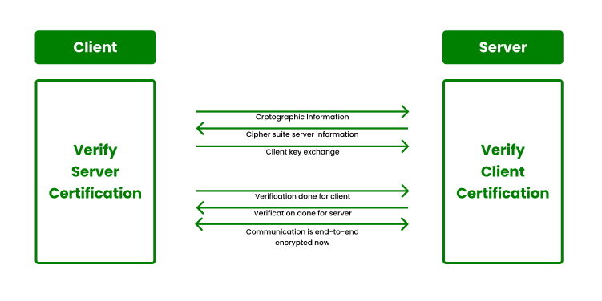
TLS Handshake protocol
Two parties: client and server
Negotiate version of the protocol and the set of
cryptographic algorithms to be used
– Interoperability between different implementations of
the protocol
Authenticate server and client (optional)
– Use digital certificates to learn each other’s public
keys and verify each other’s identity
Use public keys to establish a shared secret
Symmetric key is generated from the secret
The following is based on TLS 1.1 & 1.2

Slide 10
Benefits of TLS
Encryption
TLS /SSL can help to secure transmitted data using encryption
Interoperability
TLS/SSL works with most web browser, including Microsoft internet Exploer and +
Netscape Navigator ,and on most operating systems and web servers.
Algorithm flexibility
TLS/SSL provides options for the authentication mechanism,encryption algorithm ,
And hashing algorithm that are used during the secure session
Ease of deployment
Many applications use TLS/SSL transparently on a Windows Server 2003 OS
Ease of Use
because you implement TLS/SSL beneath the application layer, most of its operations are completely invisible to the client.

Slide 11
Encryption and decryption
Encryption is the process by which a readable message is converted to an unreadable form to prevent unauthorized parties from reading it.
It encrypts communications between a client and server ,primarily web browers and web sites/appications.
Decryption is the process of converting an encrypted message back to its original (readable) format

Slide 12
Difference’s between SSL&TLS
SSL:
SECURE SOCKE LAYER(SSL)
First version developed by Netscape in 1995
It uses explicit connections to setup secure channel
SSL is obsolete(all versions),no more recommended for use
TLS:
Transport Layer security(TLS)
First version by IETF in 1999
TLS begins its connection via protocol known as implicit connection
TLS 1.3 is the latest version – faster and secure

